Slide 1
DevFocus: FocusBot
By: Andrew Delgadillo, Brandon Fontenot, Daniel Tolessa, Mahlet Zemui

Slide 2

Problem
Developers often have many responsibilities.
Projects are broken down into multiple tasks
Frequent requirement changes lead to the addition of even more tasks
Remote work present many distractions (e.g. household distractions, digital diversions…)
Remote work decreases an individual's motivation and accountability

Slide 3
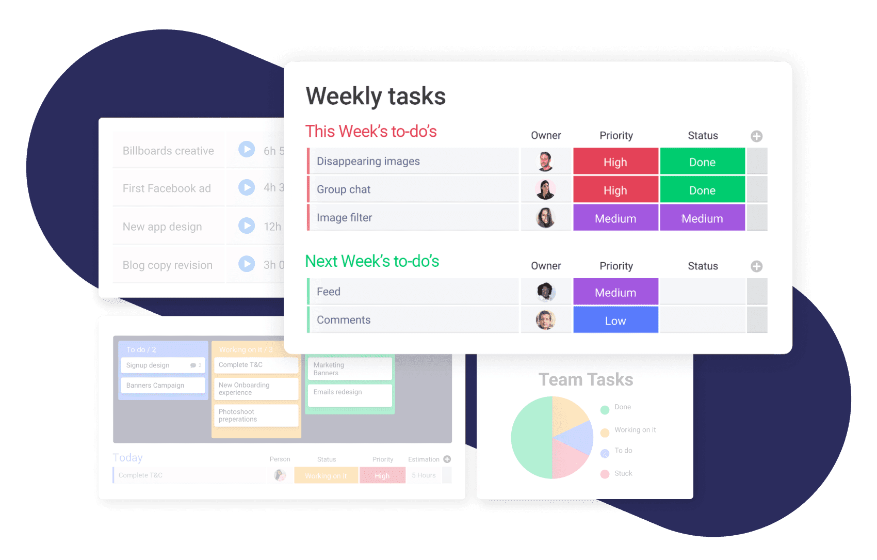
Solution
A task management tool with productivity aids
Plans weekly tasks
Tracks progress on current task
Offers suggestions to boost productivity
Enables team members to see each other's task statuses
From pending to completed and those currently underway
Able to assist other members with challenging tasks

Slide 4
Use Case: Logging Tasks
Preconditions | Main Flow | Subflows
User: is logged into app, has tasks to work on. | User will: go to the planning page and add a new task, input task information (i.e., description, priority, deadline, estimated difficulty/duration). | User will: log current working session, respond to app prompt for purpose of session (i.e., add task)

Slide 5
Relevance to teamwork in SE
Offer transparency and collaboration among team members
Allows developers to see what their colleagues are working on and possibly offer assistance
Streamline task management within a team
Allows developers the ability to assign tasks, track progress and set reminders
Enhance overall team performance
Enables developers to contribute their best work and ensure timely delivery of project milestones

Slide 6
References
[1] S. Lund, A. Madgavkar, J. Manyika, and S. Smith, "What's next for remote work: An analysis of 2,000 tasks, 800 jobs, and nine countries," McKinsey Global Institute, 2020. [Online]. Available: https://www.mckinsey.com/featured-insights/future-of-work/whats-next-for-remote-work-an-analysis-of-2000-tasks-800-jobs-and-nine-countries (Accessed Sep. 20, 2023).
[2] E. Aktaş, “The Software Engineer’s Guide to Avoid Work-From-Home Burnout,” Medium, 2020. [Online]. Available: https://betterprogramming.pub/the-software-engineers-guide-to-avoid-work-from-home-burnout-b5d887601641 (Accessed Sep. 20, 2023).
[3] “Apps to Improve Your Mental Health While Working Remotely”, Digital Health Buzz, 2021. [Online]. Available: https://digitalhealthbuzz.com/apps-to-improve-your-mental-health-while-working-remotely/ (Accessed Sep. 20, 2023).

